Slide 1
DATA ANALYTICS BOOTCAMP
MOVIES / WOMEN
ANALYZING MOVIES WITH FEMALE LEAD
TEAM: Drishti, Haidy, Sonia, Minjae

Slide 2
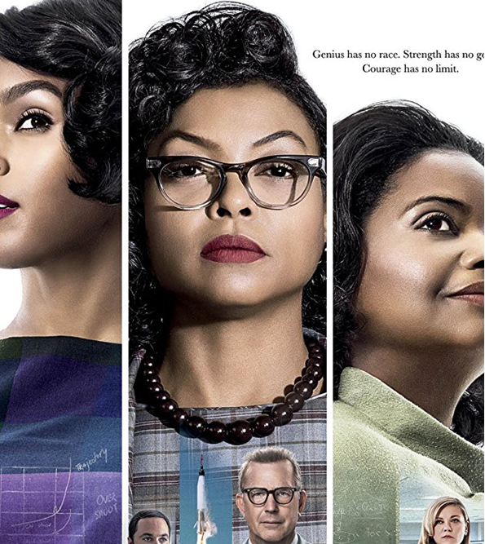
HOLLYWOOD IS A MAN'S WORLD!!! WE ANALYZED WOMEN @ THE BOX OFFICE
How many Movies that we watch, feature strong female lead?
What has been the trend since 1990?
What are the top genres with female lead?
How many female Actors led movies have made to the top at box office?
Do female actor led movies make as much money as male? Do producers want to put in as much money in female led movies as they do in movies with male lead?

Slide 3
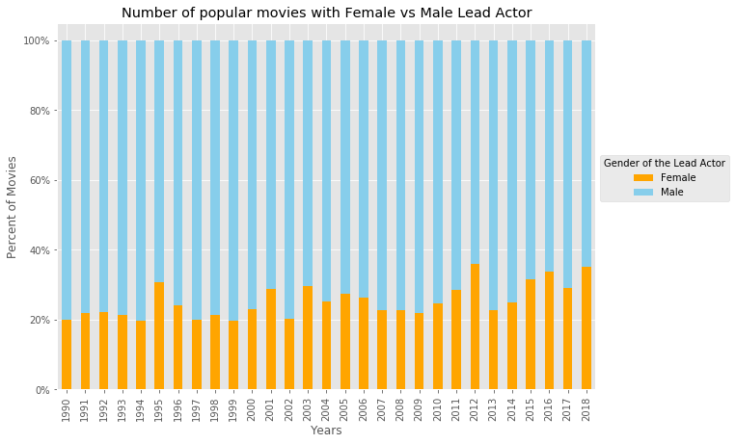
37% Female Leading roles in 2018 compared to 20% in 1990, 2000 and 2010

Slide 4
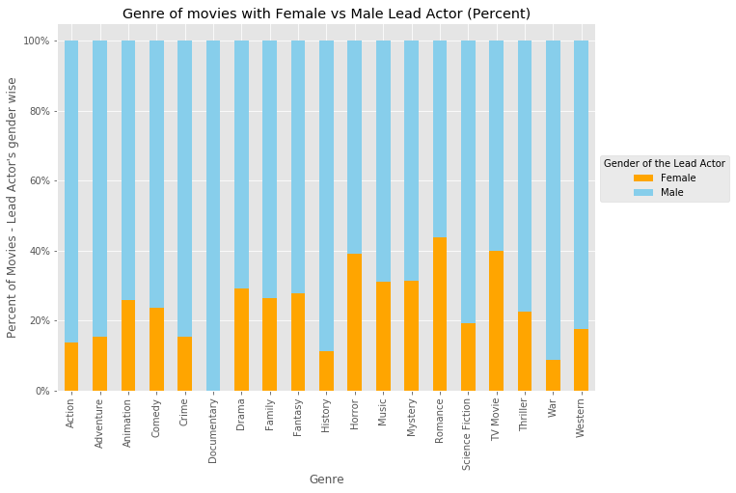
Number of Women in Lead roles are very competitive in Romance Genre. Almost 47% of romantic movies have woman in Lead. Followed by Horror and TV Movies

Slide 5
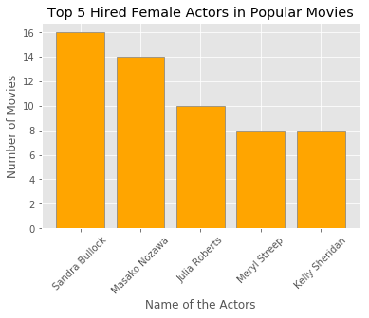
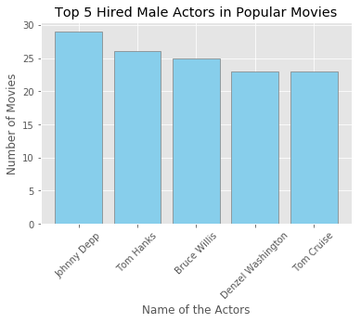
Top 5 female Artists in Popular Movies
Top 5 male Artists in Popular Movies

Slide 6
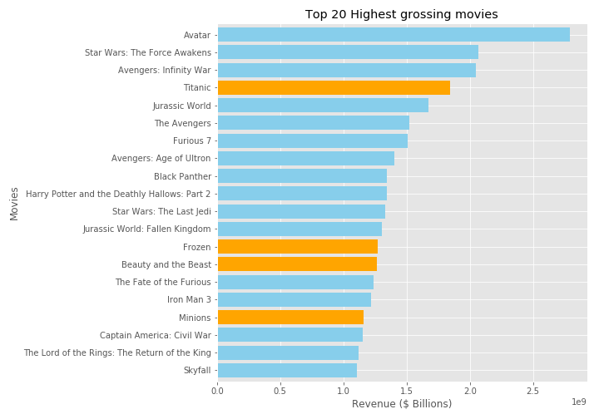
Highest Grossing movies in Billions since 1990

Slide 7
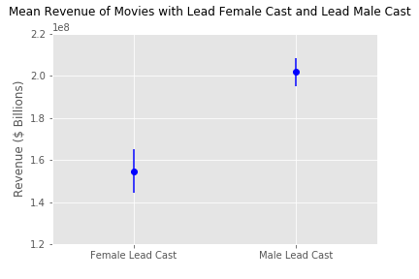
Hypothesis test I - Budget
*Hypothesis - If gender of the lead actor is related to budget of the movie, then movie casting male lead actor will have more budget as compared to movie with female lead actor.
*Null Hypothesis - If gender of the lead actor is not related to revenue of the movie, then movie casting male lead actor will not have more budget as compared to movie with female lead actor.
Result - T-Test: statistic= -7.862716, pvalue= 1.0887347320163237e-14
The mean revenue of movies with Female lead cast is $ 42,095,964. The mean revenue of movies with Male lead cast is $ 62,191,940. percent difference: 32%.
Hypothesis test II - Return on Investment
Hypothesis - If gender of the lead actor is related to revenue of the movie, then casting male lead actor will lead to more ROI as compared to ROI of movie with female lead actor.
Null Hypothesis - If gender of the lead actor is not related to revenue of the movie, then casting male lead actor will not lead to more ROI as compared to ROI of movie with female lead actor.
Result – T-Test: statistic= 1.266593, pvalue= 0.205983
No Difference

Slide 8

CONCLUSIONS
There is an increasing trend of Movies featuring strong female lead.
Female led Movies are mostly in Romance and Horror genre.
There is a strong bias in Hollywood put in more money in movies featuring strong male lead even though they make as much money as movies with strong female lead

